Slide 1
TinyCell
A Carousell-Inspired Marketplace App
Group id - 14
Bryan Ang - 2301397
Kang Ting - 2301255
Sam Tsang - 2301552
Sherman Goh - 2301472
Steven Chew - 2303348
Notes:
Hello we are team id 14,
We will be presenting on how app TinyCell, a carousell-Inspired marketplace app,
In our team, we have Bryan, kang Ting, Sam, Steven and Me

Slide 2
Introduction

Slide 3
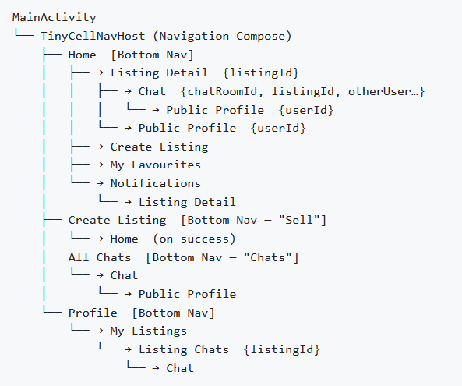
What Our App Does
Create listings with images
Browse & search
Chat between users
Make offers
Accept/reject offers
Leave reviews
Favourite listings
Notifications
Browse → Chat → Offer → Accept → Review
Notes:
“We built a full buyer-seller transaction loop using MVVM, Room, and Firebase.”
Browse → Chat → Offer → Accept → Review
“Our goal was to complete the full transaction lifecycle.”

Slide 4
Architecture
(Back-end)

Slide 5
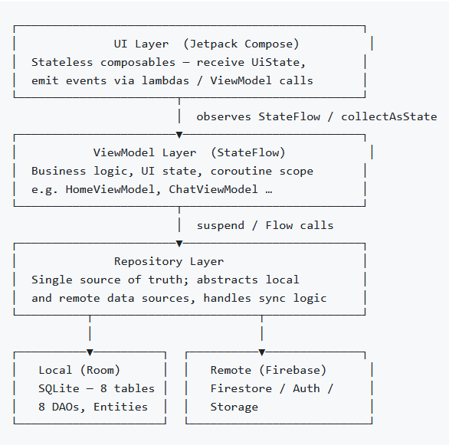
MVVM Architecture
Model
Data layer - Repos, database, Firebase
View
UI layer
ViewModel
Bridge that manages UI state & business logic
Separation of concerns
Layers are well defined in roles
Notes:
I'll be explaining how we implemented the MVVM architecture in our TinyCell marketplace app, and specifically how data flows through our application.
MVVM stands for Model-View-ViewModel. It's an architectural pattern that separates our app into three distinct layers:
Model: Our data layer - the Room database and Firebase repositories
View: Our UI layer - built with Jetpack Compose
ViewModel: The bridge that manages UI state and business logic
The key advantage of MVVM is separation of concerns - each layer has a single, well-defined responsibility.
Understanding "Single Source of Truth"
In our architecture, we have two different "single sources of truth":
ViewModel = Single source of truth for UI State
All UI state (what the user sees) lives in the ViewModel
The UI never manages its own state - it only observes the ViewModel
Repository = Single source of truth for Data
Abstracts whether data comes from local (Room) or remote (Firebase)
The ViewModel doesn't care where data comes from - it just asks the Repository
This separation ensures consistency: UI state is always predictable, and data access is always centralized.
In our app, we follow a strict unidirectional data flow pattern. Think of it like a one-way street:
Downward Flow: State flows from ViewModel to UI
The ViewModel is the single source of truth for UI state
State is exposed through StateFlow and Flow objects
The UI observes these flows and automatically recomposes when data changes
The UI never stores its own state - it's completely stateless
Upward Flow: Events flow from UI to ViewModel
User interactions trigger event callbacks
These events are passed up to the ViewModel as function calls
The ViewModel processes the event and updates the state
State update triggers downward flow again
The Repository Layer
Repository is the single source of truth for data
It abstracts local (Room SQLite) and remote (Firebase) data sources
ViewModel calls Repository functions via suspend functions or Flows
Repository handles sync logic between local and remote

Slide 6
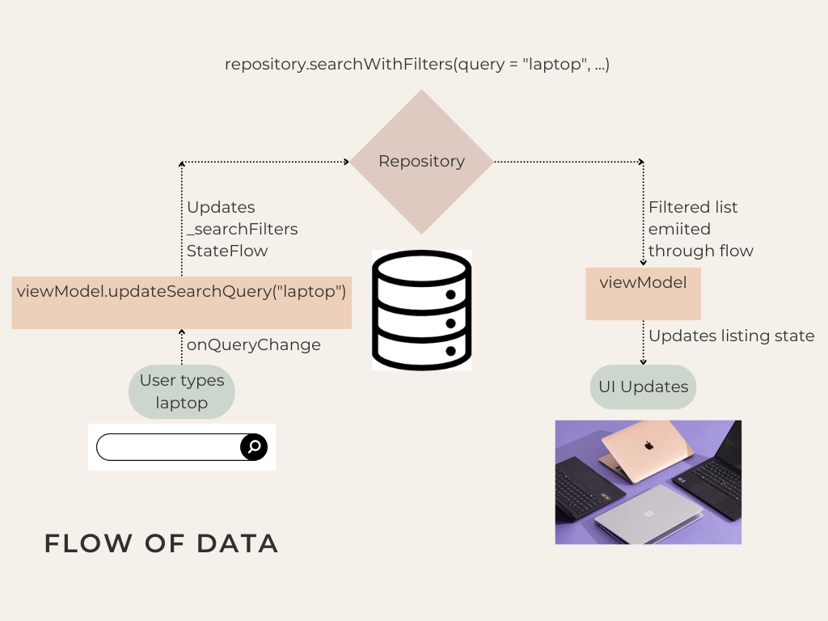
MVVM Architecture
Upward Flow
Event callbacks triggered by user
Events passed to ViewModel as function calls
ViewModel handles event and updates
Downward Flow
ViewModel handles state
UI observes the state
UI recomposes when state changes

Slide 7
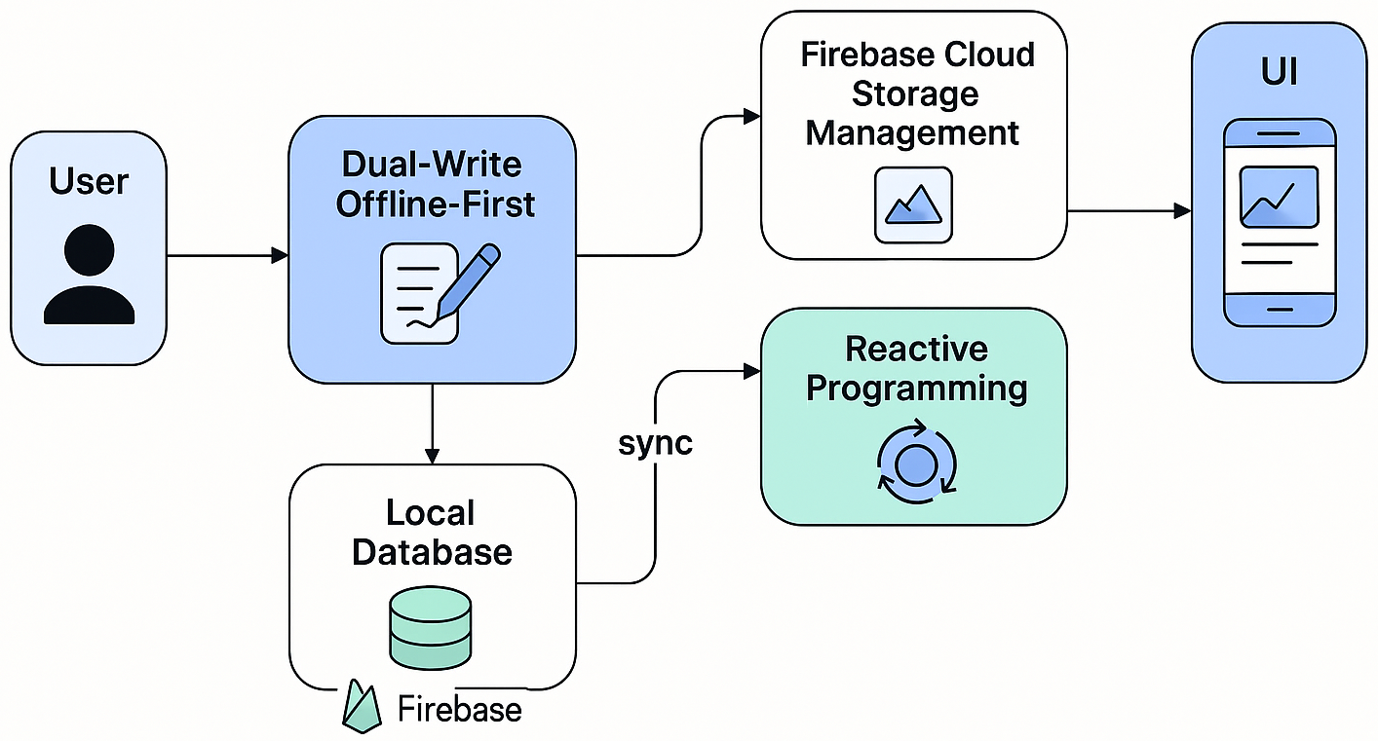
Data Sync & Advanced Techniques
Dual-Write Offline-First:
Writes to both local and remote
Local database as single source of truth
Real-time sync to remote
Reactive Programming:
StateFlow & Coroutines to propagate
Coroutines are launched in the background to improve ui responsiveness
Firebase Cloud Storage Management:
Image Compression
Notes:
Talking points:
Dual-Write Offline-first: writing to both local and remote databases improves data persistence and resilience. It ensures that user can continue have a functional and responsive application even when the connection to remote is interrupted or down. The bidirectional real time remote sync ensures that the data will eventually reach the remote database when the connection is restored.
Reactive Programming: stateflow and coroutines ensures that the change is propagated seamlessly when the stateflow is observed or when the coroutines are launched in the background. This provides a seamless and responsive ux
Firebase Cloud Storage Management: image compression reduces the file size and the network strain on both endpoints. The batched uploads reduces the overall upload time by overlapping multiple network transfers.
These techniques combine to create a **professional-grade experience**:
📱 **Offline-first**: User creates listing on subway → Syncs when they get home
⚡ **Instant filtering**: Search feels native, not like a network request
🔔 **Real-time notifications**: Seller gets offer alert in < 1 second
🖼️ **Fast uploads**: 3 photos upload in ~2 seconds with compression
🔄 **Multi-device sync**: Edit on phone → See changes on tablet instantly
Prob just gonna do data persistence and resilience
Choose one
Local-first with Room
Firestore sync
Dual-write strategy
Offline resilience
Coroutines & StateFlow
Real-time listeners
Cloud Storage for images
Should go find what things are being done on the Coroutines.

Slide 8
User Flow
(UI/UX)

Slide 9
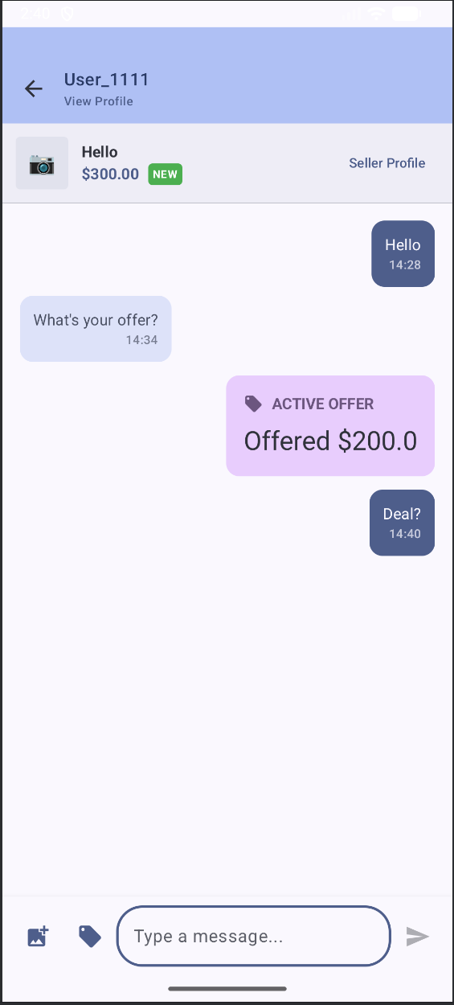
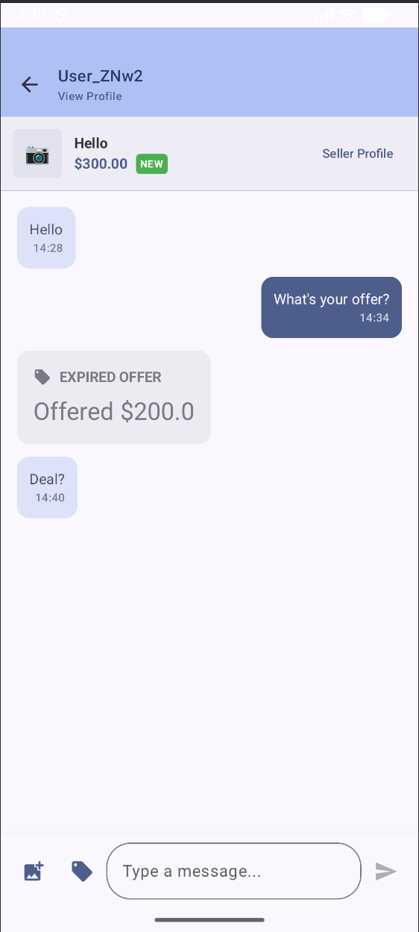
Chat & Offer Lifecycle
Buyer’s perspective
Seller’s perspective
Chat is real-time
Offer system structured negotiation
Listing status updates
Review enabled after acceptance
Notes:
Screen recordings:
Open chat
Send message
Make offer
Accept offer
Leave review
Explain:
Chat is real-time
Offer system structured negotiation
Listing status updates
Review enabled after acceptance

Slide 10
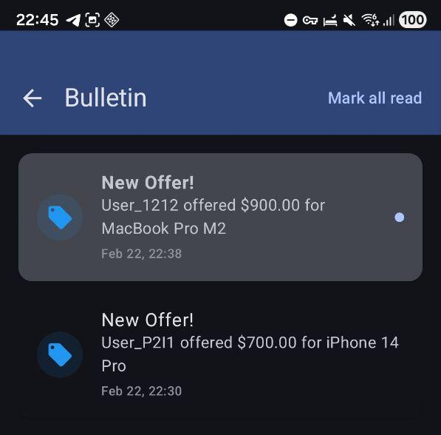
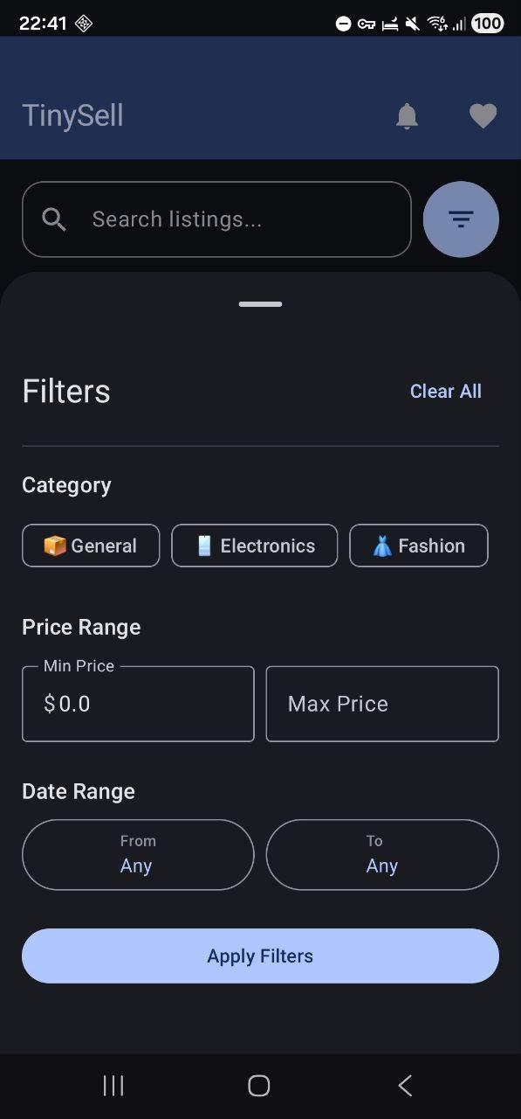
Search & Notifications
Notifications:
Notifications are generated on key events (new offer, accepted offer, price change, status change) and stored in both Room and Firestore. The HomeScreen displays a notification bell that when clicked will show all the unread message
Search & Filter:
The Home screen supports multi-dimensional filtering, all executed as a single Room query:
Full-text search on title and description
Category multi-select (Electronics, Fashion, Home, Toys, Books, General)
Price range (min / max slider)
Date range filter
Active listings only (excludes sold items)
Notes:
Show:
Search bar
Category filter
Price filter
Favourites
Notification badge

Slide 11
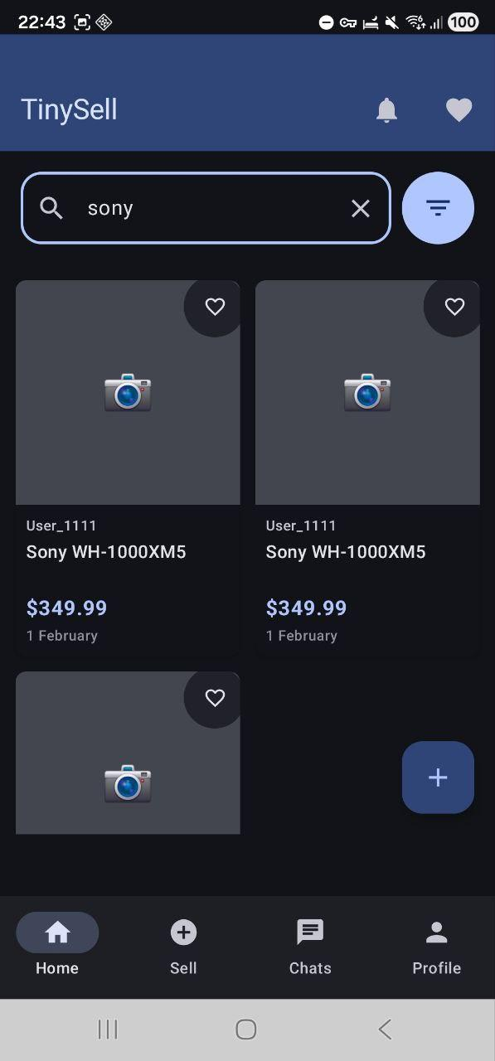
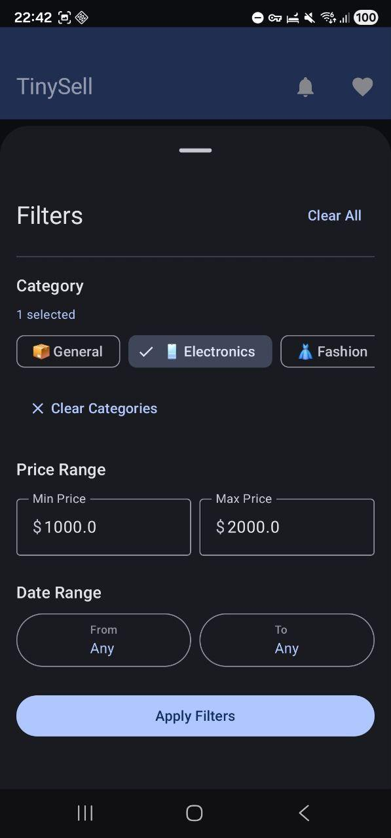
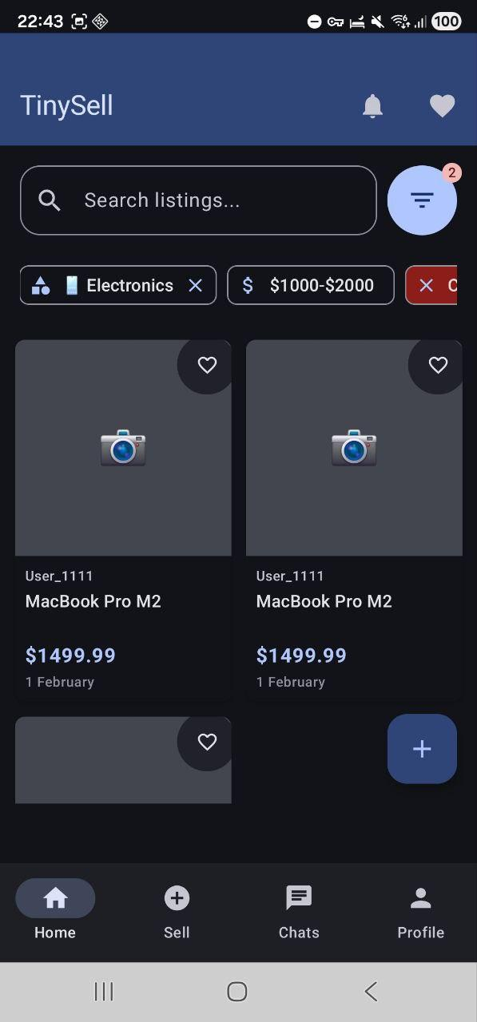
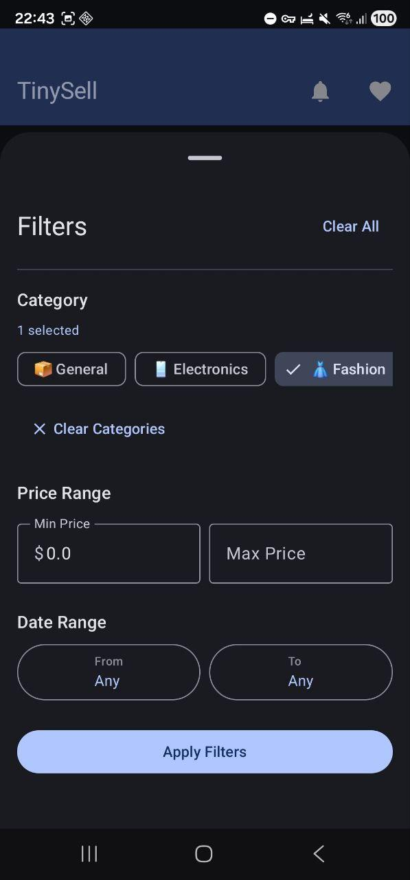
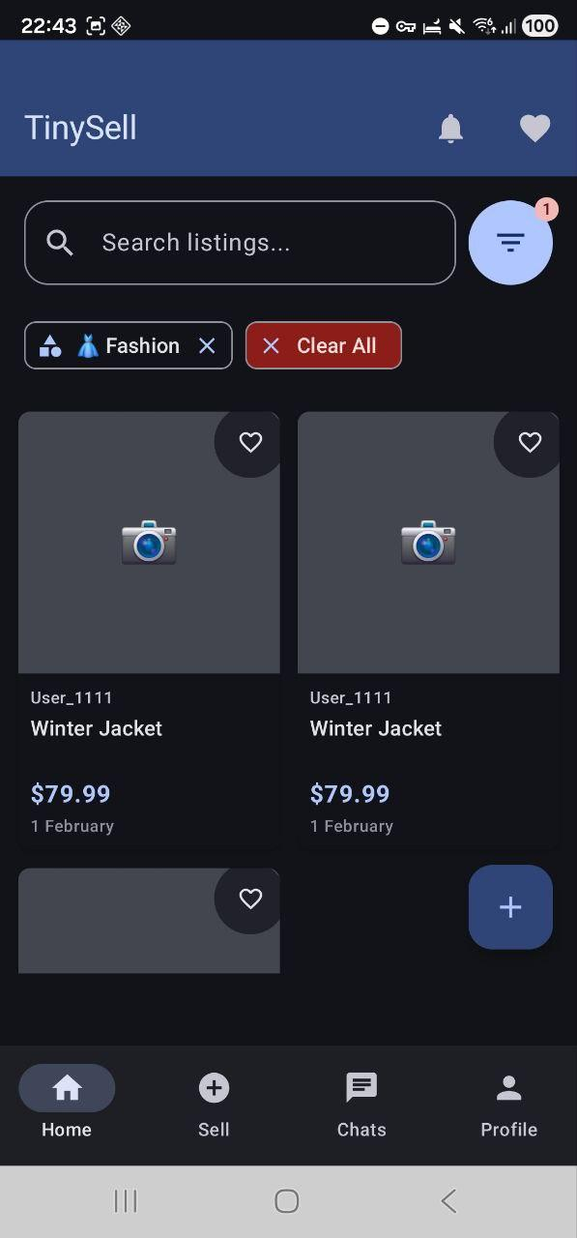
Search (Sam)
Notes:
Show:
Search bar
Category filter
Price filter
Favourites
Notification badge

Slide 12
Summary ( Technical Features Implemented )
MVVM
Room Database
Firebase Firestore
Firebase Storage
Coroutines
Camera integration
Reactive UI with StateFlow
Navigation architecture

Slide 13
Reflection
Notes:
Importance of user flow
Importance of state-driven design
Balancing scope vs stability
Learning real multi-user sync

